Slide 1

Predicting the Diagnosis of the Breast Tumors
Marta Matosas Fonolleda
April 28th, 2020

Slide 2
The motivation
Breast cancer is the most frequently diagnosed cancer in women.
The leading cause of cancer death in women worldwide.
In 2016, an estimated 1.7 million new cases and 545,000 deaths were due to breast cancer.
If breast cancer is detected early, there are more treatment options and a better chance for survival.
The accuracy of diagnosis by Fine Needle Aspirate biopsy is 85%.

Slide 3
The data gathering
A small fraction of a Fine Needle Aspirate slide is selected and digitized.
With an interactive interface, the user selects a set of cell nuclei.
The system allows for precise and automated analysis of the nuclear size, shape and texture.
The features are computed for each nucleus; the mean value, the largest value and the standard error of each feature are found over the range of cells.

Slide 4
The data
569 samples and 30 features.
The 30 features are divided in 3 “sets” -the “mean”, the “worst” (largest) and the “standard error”- of the same 10 features:
Radius (mean of distances from center to points on the perimeter)
Perimeter
Area
Texture (standard deviation of gray-scale values)
Smoothness (local variation in radius lengths)
Compactness (perimeter^2 / area - 1.0)
Concavity (severity of concave portions of the contour)
Concave points (number of concave portions of the contour)
Symmetry
Fractal dimension ("coastline approximation“)

Slide 5
The data inspection & pre-processing
The target is the diagnosis of the breast tissue: malignant or benign. Since the target is discrete and binary, this is a binary classification problem.
All features are numerical with 4 significant digits -> standardize.
No missing values.
There is no evidence of noisy or inconsistent data such as duplicates, values out of range or due to human errors (errors or duplicates).
Link to dataset: https://www.kaggle.com/uciml/breast-cancer-wisconsin-data

Slide 6
The demo

Slide 7
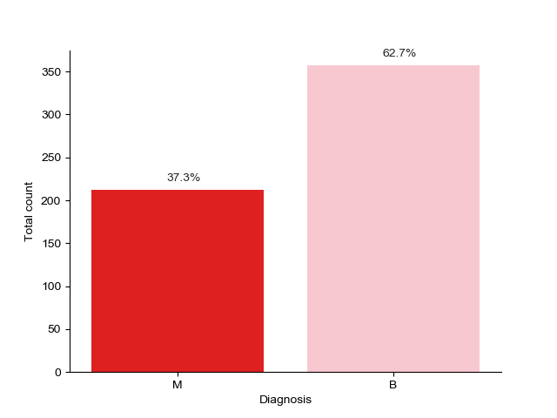
EDA Class labels

Slide 8
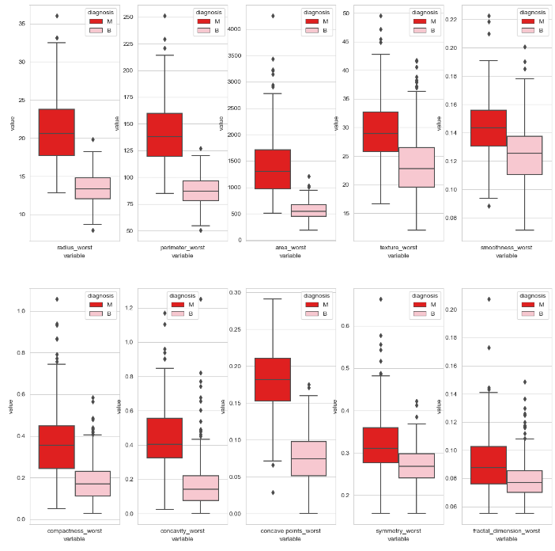
EDA Features part II

Slide 9
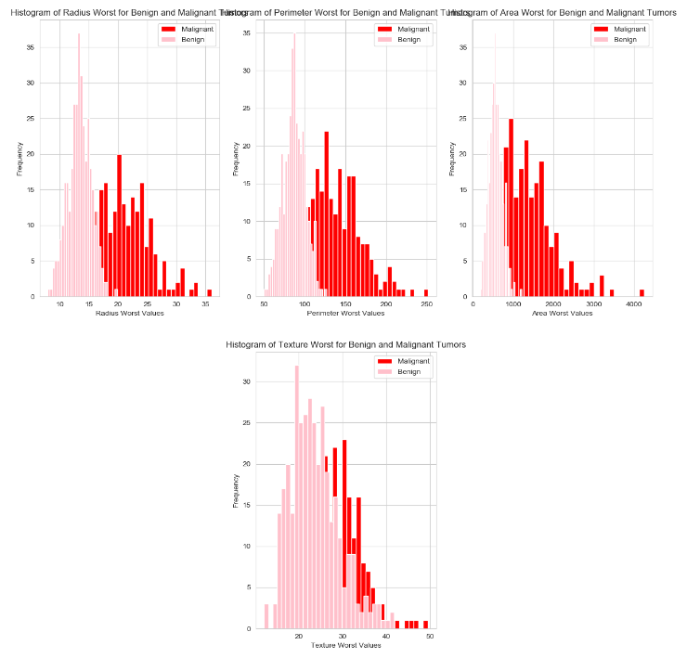
EDA Features part III

Slide 10
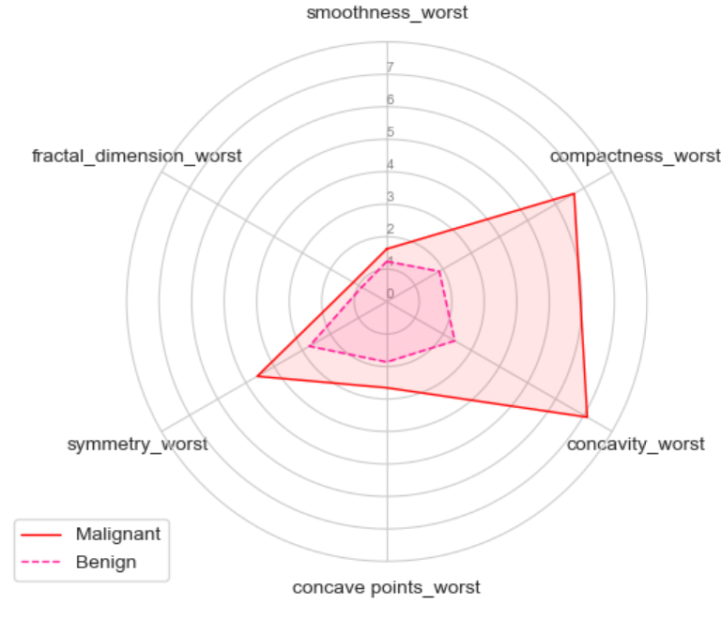
EDA Features part IV

Slide 11
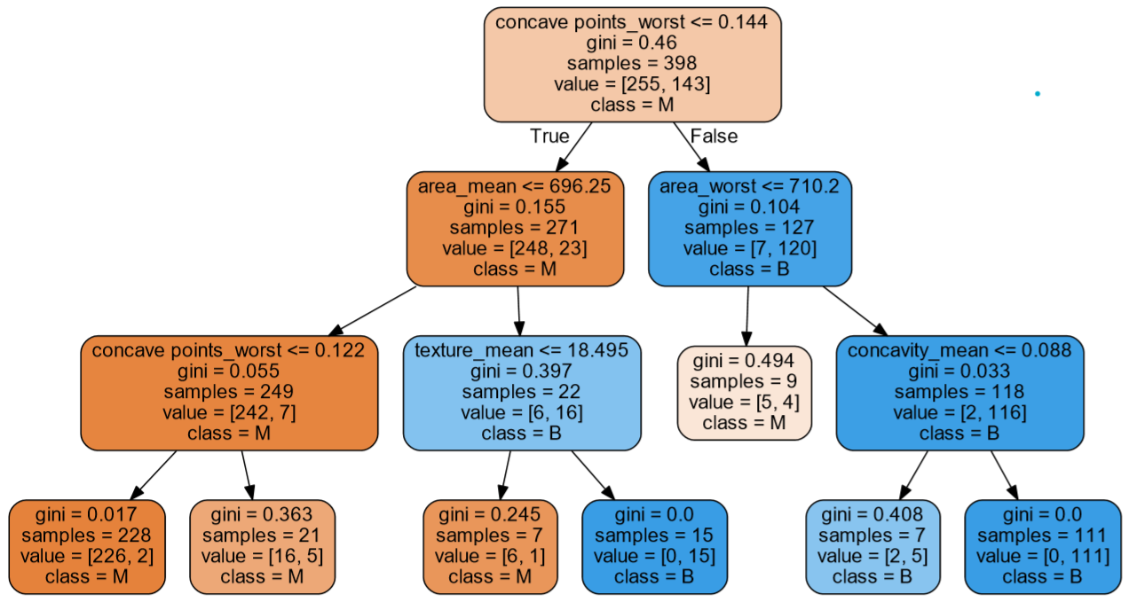
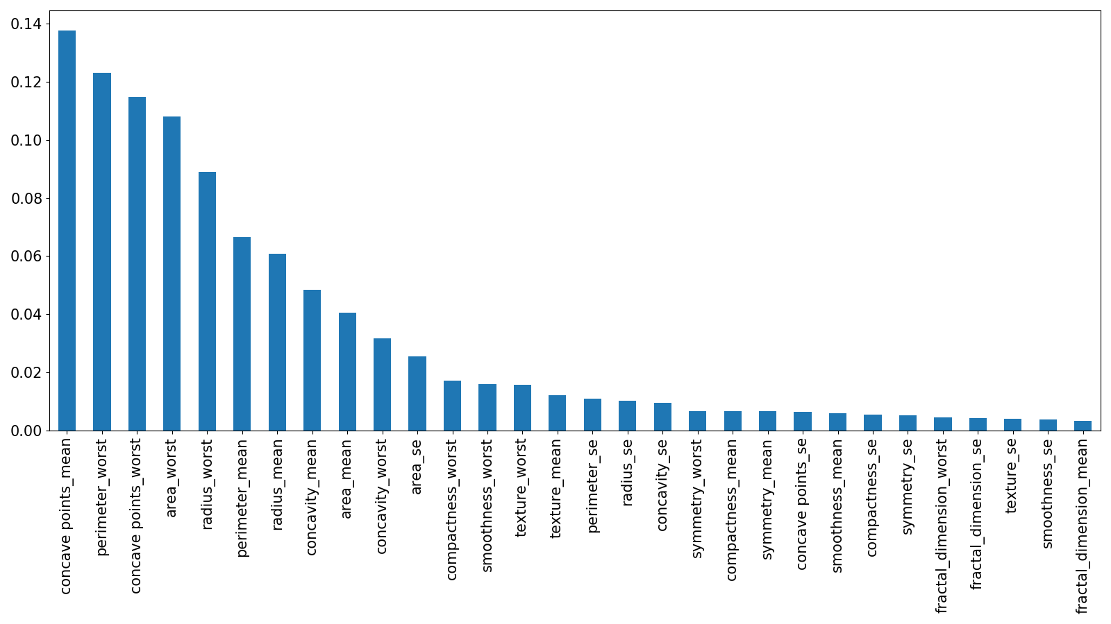
Feature Importance
Decision Tree – Gini Criterion
Feature Importance Random Forest

Slide 12
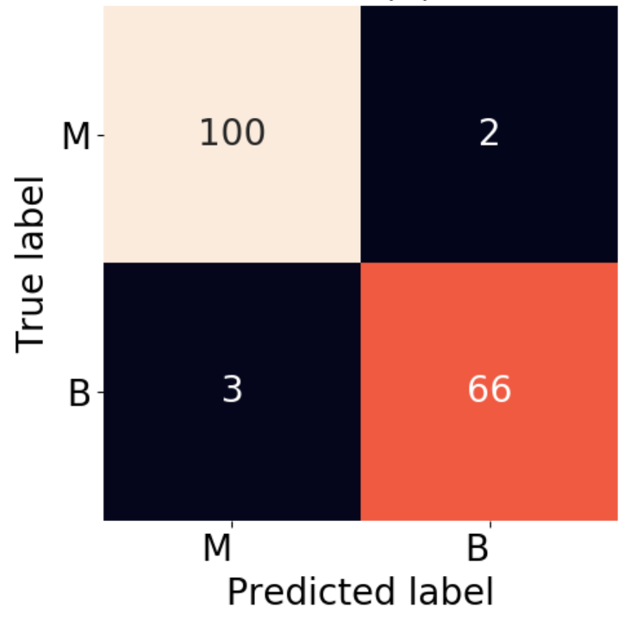
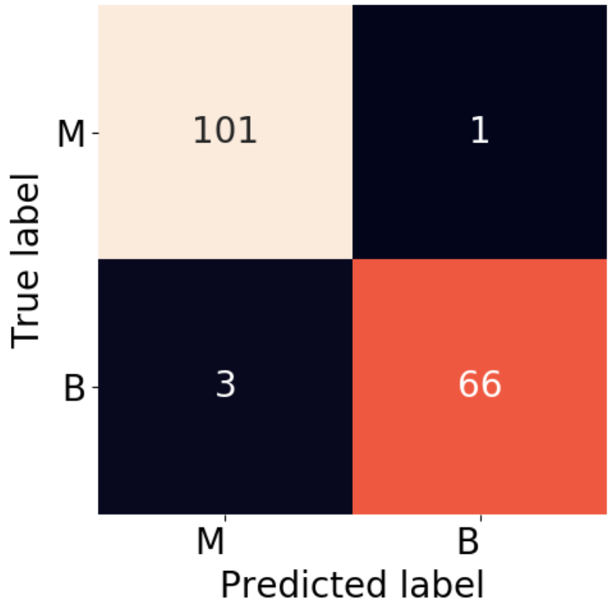
Feature Selection
Random Forest - Confusion Matrix
Random Forest - Confusion Matrix
List of features from the paper:
[texture_mean, area_worst, smoothness_worst]
Accuracy: 97.07
ROC_AUC: 99.60
Custom list of features:
[texture_mean, area_worst, smoothness_worst,
area_mean, concavity_mean]
Accuracy: 97.66
ROC_AUC: 99.53

Slide 13
Modeling
SVC
Accuracy: 0.9773717948717948
Best hyper parameters: {'clf__C': 11, 'clf__gamma': 0.01, 'clf__kernel': 'rbf’}
Logistic Regression
Accuracy: 0.9748717948717948
Best hyper parameters: {'clf__C': 10, 'clf__multi_class': 'ovr', 'clf__solver': 'newton-cg’}
XGBoost
Accuracy: 0.9699358974358974
Best hyper parameters: {'clf__eta': 0.1, 'clf__gamma': 0, 'clf__lambda': 1}
Random Forest
Accuracy: 0.9623717948717948
Best hyper parameters: {'clf__max_depth': 5, 'clf__min_samples_leaf': 5, 'clf__min_samples_split': 2, 'clf__n_estimators': 100}
KNN
Accuracy: 0.9598076923076923
Best hyper parameters: {'clf__algorithm': 'auto', 'clf__leaf_size': 1, 'clf__n_neighbors': 11}
Decision Tree:
Accuracy: 0.9573717948717949
Best hyper parameters: {'clf__min_samples_leaf': 3, 'clf__min_samples_split': 2}

Slide 14
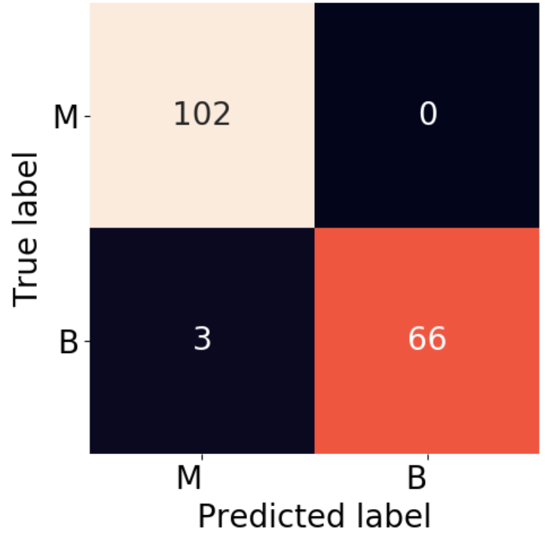
Evaluation
LOGISTIC REGRESSION
ROC_AUC Score:
0.9782608695652174
Classification Report:
precision recall f1-score
M 1.00 0.96 0.98
B 0.97 1.00 0.99

Slide 15
Future work
Further investigate the feature space.
Implement ensemble methods.

Slide 16

Thank you !

Slide 17
Bibliography
https://www.researchgate.net/figure/Global-burden-of-breast-cancer-by-continents-per-100-000-women-per-yearbased-on-Ferlay_fig2_323991514
https://www.breastcancer.org/symptoms/understand_bc/statistics
https://www.cancer.org/content/dam/cancer-org/research/cancer-facts-and-statistics/annual-cancer-facts-and-figures/2020/cancer-facts-and-figures-2020.pdf
https://www.ascopost.com/News/60293
https://www.ncbi.nlm.nih.gov/books/NBK470268/
https://www.archivesofpathology.org/doi/pdf/10.5858/arpa.2018-0463-RA
https://www.europadonna.org/breast-cancer-facs/

